Slide 1

This supplement is sponsored by Flu Lab, World Health Organization, the International Society for Respiratory Viruses, F. Hoffmann-La Roche AG, Shionogi & Co., Ltd., Cidara Therapeutics, Inc., Eradivir Inc, Leyden Laboratories, Gilead Sciences, and the International Federation of Pharmaceutical Manufacturers & Associations.

Slide 2
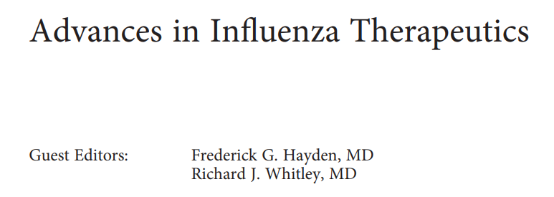
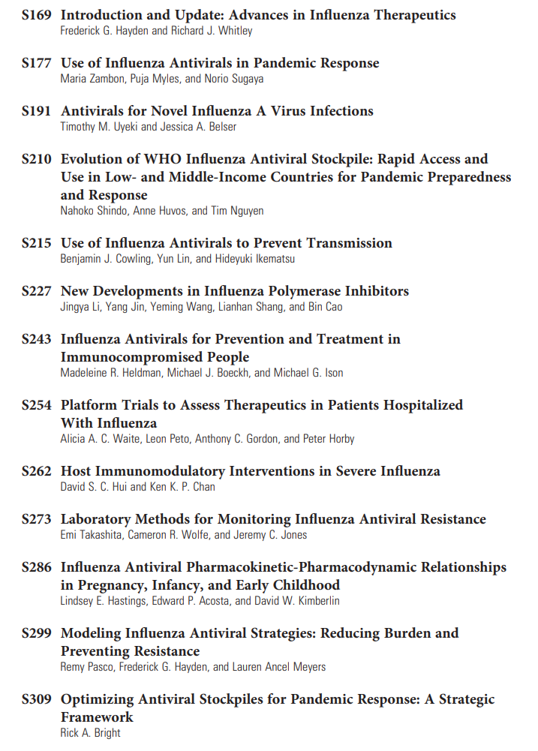

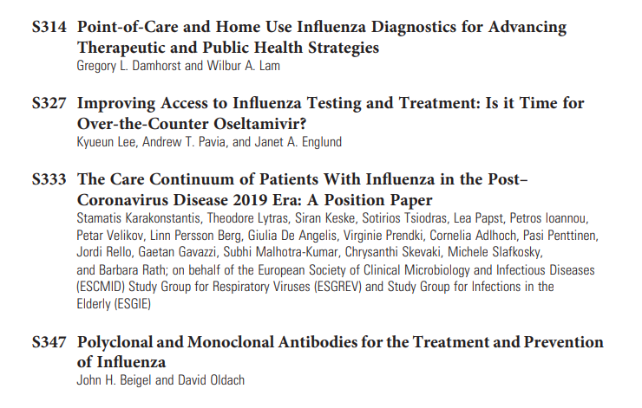
https://academic.oup.com/jid/issue/232/Supplement_3.

